Slide 1

An Internship Report Presentation On
WEB
DEVELOPMENT
Submitted by SURYAKANT CHAUDHARY U03EC23S0151 | BCA VI Semester (May-2026) Harsha Institute Of Management Studies
Codec Technologies Pvt. Ltd. | Bengaluru | 06-04-2026 to 06-05-2026

Slide 2
About The Organization
Training Institute
30
Codec Technologies is a premier training institute based in Bengaluru, focused on bridging the gap between academic theory and industry needs.
Days
Internship
Courses Offered
Provides hands-on training in Web Development, AI, Machine Learning, Data Analytics, and Cybersecurity.
5+
Approvals
Tech
Domains
AICTE and ICAC approved organization, ensuring globally recognized certification.
Internship Duration
AICTE
06-04-2026 to 06-05-2026 — 30-day online internship with virtual sessions, study materials, and project guidance.
Approved
Web Development Internship
Slide 2

Slide 3
Introduction to Web Development
HTML
CSS
JS
MySQL
PHP
Structure
Styling
Interactivity
Database
Server-side
Web development involves building and maintaining websites — from simple static pages to complex interactive applications.
HTML structures the content, CSS styles its appearance, and JavaScript adds interactivity and dynamic behavior.
MySQL manages relational databases to store, retrieve, and manipulate data efficiently for web applications.
PHP is a server-side scripting language that connects the front-end interface to the database and business logic.
Web Development Internship
Slide 3

Slide 4
Significance of Websites
🌐 Online Presence
📡 Global Reach
Acts as a digital representation of businesses and individuals, establishing credibility and professionalism.
Enables businesses to connect with a worldwide audience, breaking geographical barriers and expanding markets.
🕐 24/7 Availability
📢 Marketing & Branding
Accessible at any time, allowing businesses to generate leads and provide services outside regular hours.
Serves as a powerful marketing tool, improving visibility and brand recognition through SEO and content.
🛒 E-Commerce
🏆 Competitive Advantage
Enables direct online sales, expanding revenue streams and providing a seamless shopping experience.
Differentiates businesses from competitors with unique offerings, compelling visuals, and exceptional UX.
Web Development Internship
Slide 4

Slide 5
Technologies & Tools Mastered
Core Languages & Frameworks
Data, Tools & Environments
HTML5
MySQL
Page structure, semantic elements, forms
Database design, CRUD operations, advanced queries
CSS3
APIs
Selectors, flexbox, responsive design, media queries
Consuming and integrating third-party external APIs
JavaScript
VS Code
DOM manipulation, event handling, form validation
Primary IDE for development and debugging
PHP
Responsive
Server-side scripting, MVC architecture, Laravel/CodeIgniter
CSS frameworks, mobile-first design principles
Web Development Internship
Slide 5

Slide 6
Training Progression — 30 Days
1
Days 1–3 — HTML, CSS & JavaScript
HTML structure/tags, CSS selectors/styling, JS syntax, DOM manipulation, form validation.
2
Days 4–6 — MySQL & PHP
Database design, CRUD operations, PHP scripting, connecting front-end to MySQL backend.
3
Days 7–11 — Advanced Web Dev
PHP frameworks (Laravel/CodeIgniter), MVC architecture, APIs, security, performance optimization.
4
Days 12–14 — Testing & Debugging
Unit testing, debugging techniques, web application security and performance optimization.
5
Day 15 — Project Presentation
Android Workshop + Placement Training Test — showcasing mini-project to evaluators.
Web Development Internship
Slide 6

Slide 7
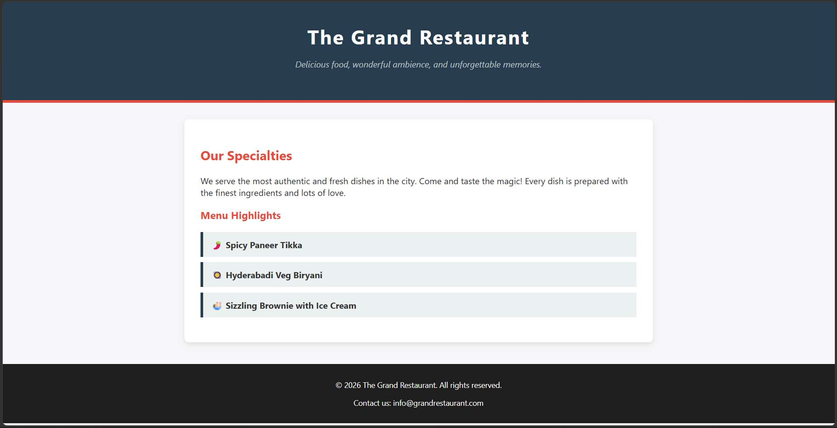
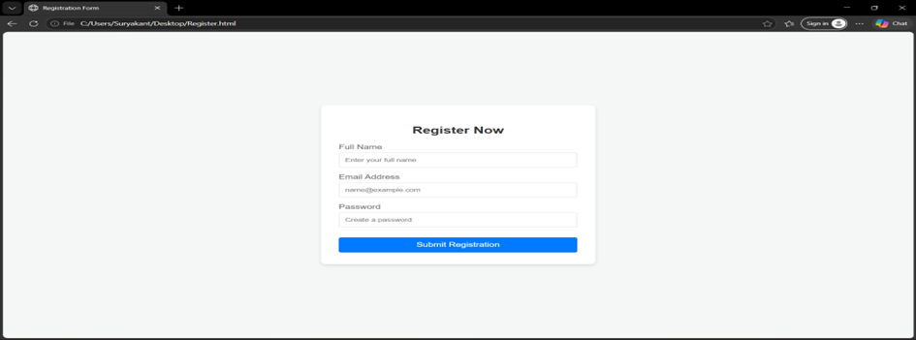
Project Output-Restaurant Webpage & Registeration Form
01
HTML Webpage
Built 'The Grand Restaurant' page with navbar, specialties section, menu highlights & footer.
02
HTML FORM
This internship has significantly boosted my confidence and served as a strong foundation for my career as a Full-Stack Web Developer.
Dynamic PHP Page
Web Development Internship
Slide 7

Slide 8
Conclusion
01
Successfully gained comprehensive knowledge of full-stack web development using HTML, CSS, JavaScript, PHP, and MySQL.
02
Developed real-world projects such as a dynamic Restaurant Website with database integration and CRUD functionalities.
03
Enhanced practical skills in database management, API integration, web security, and performance optimization.
04
This internship has significantly boosted my confidence and served as a strong foundation for my career as a Full-Stack Web Developer.
THANK YOU
Suryakant Chaudhary | U03EC23S0151 | BCA VI Semester | Harsha Institute Of Management Studies

